Slide 1
Introduction to FPGA Simulation and Debug

Slide 2
Objective
Understand and select appropriate debugging tools for FPGA designs.
Hands on use of four different FPGA debug tools
Simulation
Modelsim
Actual Hardware
In-System Sources and Probes
Signal Tap Logic Analyzer
System Console Instrumentation
Notes:
The objective of this course is to familiarize students with various debugging tools available in Quartus by giving an introduction on how to use those tools. Further, try to understand which type of tool would be used to debug which designs. After completion of the labs, the student will be able to use Modelsim, have basic knowledge of signal tap , in-system signals and probe and System Console. We will start with Simulation Debugging Tool – Modelsim , move on to ISSP and Signal Tap and end with system Console

Slide 3
Simulation with ModelSim

Slide 4
Why Simulation?
+ Include wide range of analyses
+ Reduce development costs
+ Brings innovative products faster to market
+ Provide results that are impossible to measure on physical prototype.
+ High visibility of all signals in design
- Can take a very long time to run for large designs or excessive stimulus
- Designer has to predict and create stimulus that matches actual behavior
Notes:
Why would you use simulations for debugging? There are a lot of pros for using simulation for debugging. Firstly, design simulations are able to include wide range of analyses that virtually test behavior of a product under various operating and environmental conditions. As opposed to trial-and-error, a smart simulation process allows targeted implementation of design choices in various stages of the development cycle.
This drastically reduces the need for recurrent, time-consuming testing on expensive physical prototypes, and subsequently shortens the total development time. An effective design simulation process helps companies reduce development costs and bring innovative products to the market faster than the competition. Also, simulations may provide results through simulation models which are hard or even impossible to measure on physical prototypes.

Slide 5
Testbenches
TESTBENCH
A test bench or testing workbench is an environment used to verify the correctness or soundness of a design or model.
Design Under Test
(DUT)
Stimulus
Output

Slide 6
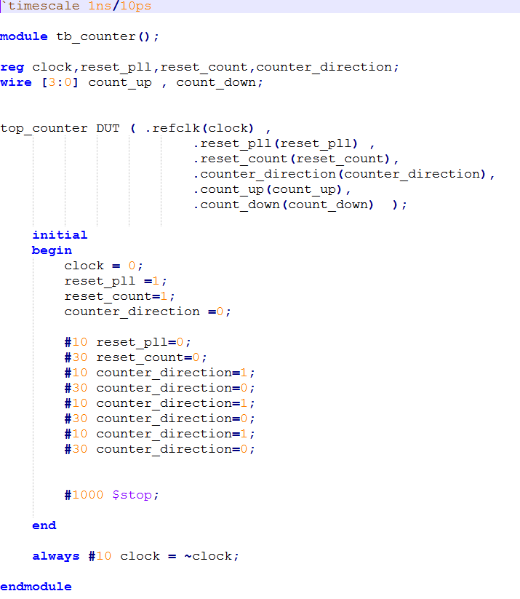
Verilog Testbench Constructs
Timescale
1st number is units, second is timing resolution
Inputs are reg, outputs are wires
Note: no module I/O
Initial Block
Runs only once (vs always block)
Stimulus
Best to change stimulus on the inactive edge of the clock – easier to read waveforms
Use $stop vs $finish or simulator closes
Clock

Slide 7
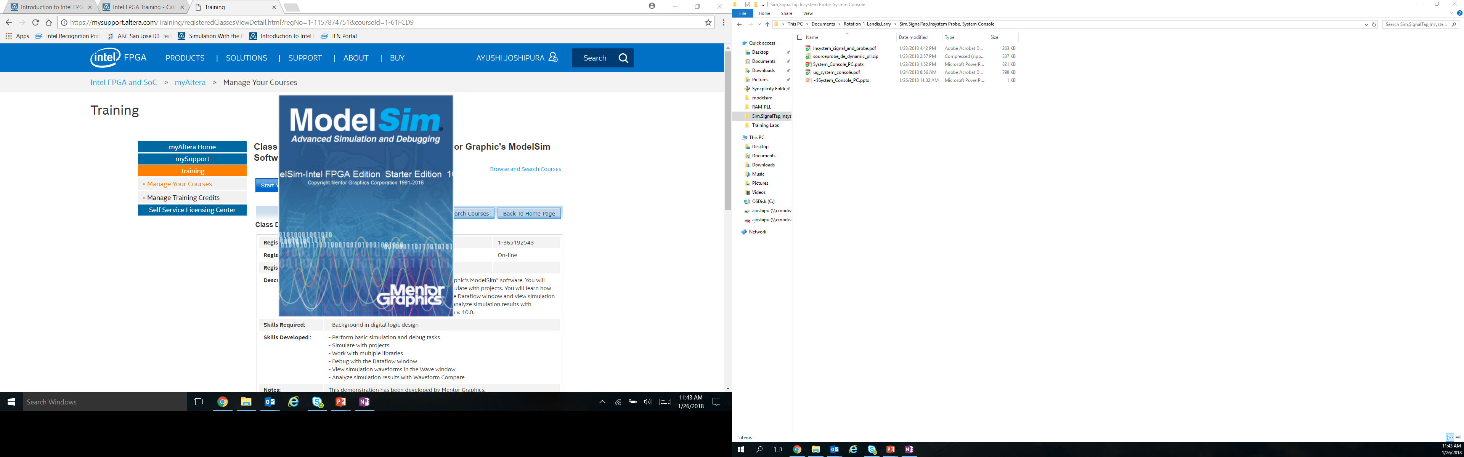
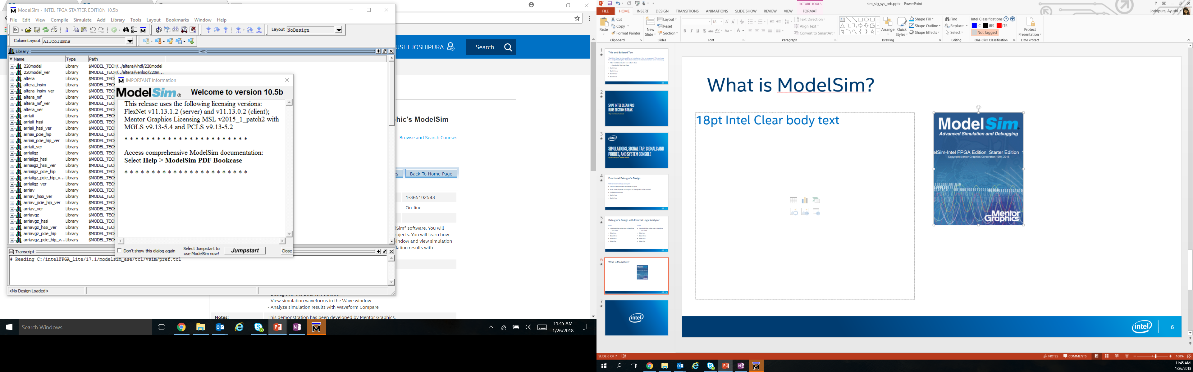
Mentor ModelSim Overview
ModelSim is a multi-language HDL (Verilog/VHDL) simulation environment. It can be used independently or Intel Quartus can create startup scripts and link designs to ModelSim.
Intel Quartus has a license to distribute Modelsim-Altera with Quartus .
Free Starter Edition: <=10K lines of code, runs slower
Notes:
For simulation debugging, we use the Modelsim Software. Modelsim is a multi-language HDL Simulation environment that can be used independently or Quartus can help create libraries and link the designs to ModelSim. For designs, proper functionality and timing is important to ensure success and ModelSim software simplifies it.

Slide 8
ModelSim
Create Project
Performed in Quartus
Compile Design
Note:
Only functional (non-timing) simulation is supported
Back-annotated timing model gate level simulations are not supported
Startup Script
Simulate
This script will link in all of external IP libraries so you don’t have to
OK
NO
Fix Design
YES
Done
Notes:
To verify that a design operates correctly we use simulation, which is a process of testing the design by applying inputs to a circuit and observing its behavior. The output of a simulation is a set of waveforms that show how a circuit behaves based on a given sequence of inputs. For using ModelSim from Quartus, we first create a project and compile the design in Quartus itself. Then use the modelsim tool for simulation debugging for the design. If the design is not working as required, we go back and fix the design and reiterate the steps until the design is functioning properly.

Slide 9
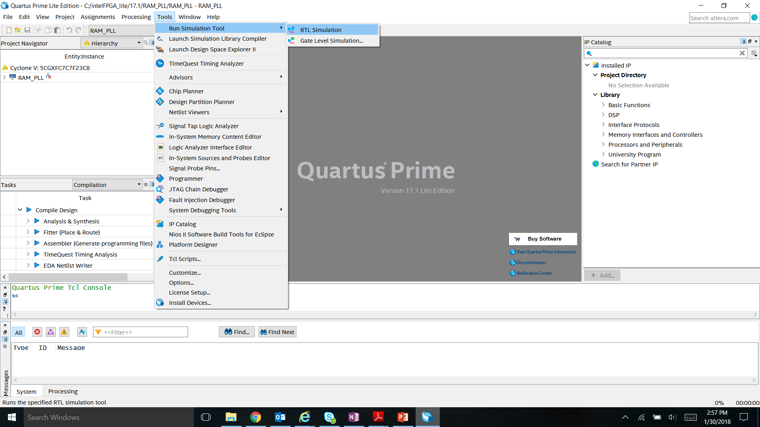
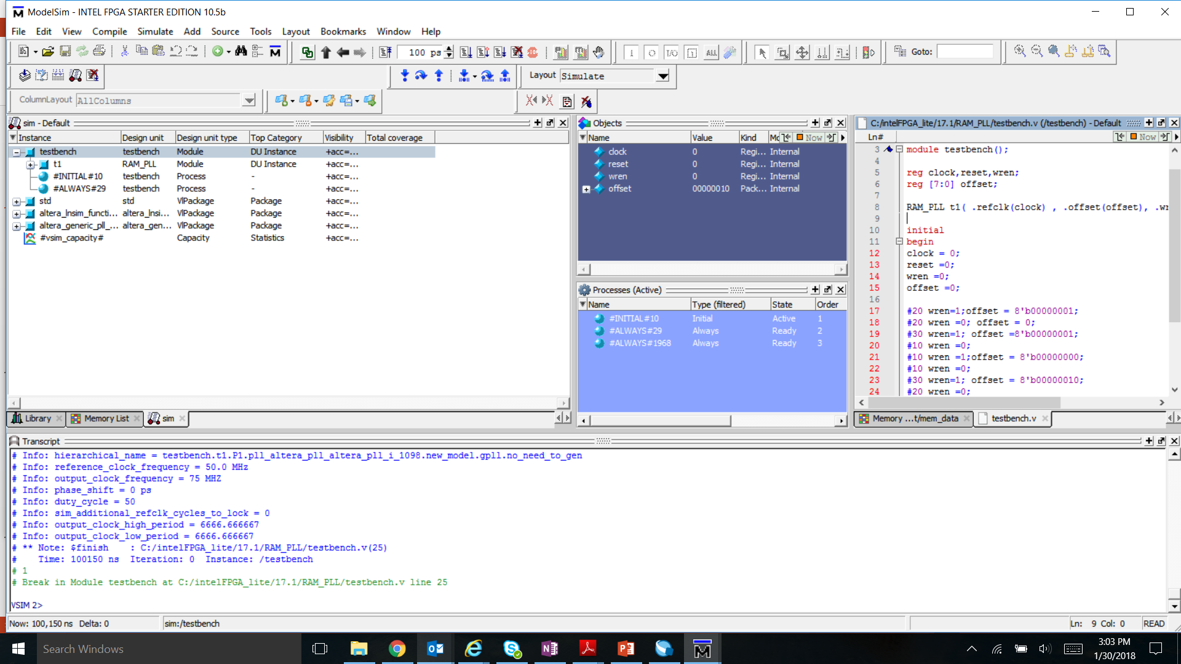
ModelSim GUI
Launching ModelSim from Quartus Tools →Run Simulation Tool → RTL Simulation
Simulation Objects
Testbench File
Command Transcript Window
Notes:
Show ModelSIM GUI. //DEMO
When Modelsim opens up, you will see all these windows. Each window has a different use. Transcript window allows you to write commands to run/stop simulations/ load designs. Simulation objects window allows you to view all different objects defined in the design. The files windows allows you to view Testbench and all the design files.
Different windows – transcript, files, simulation objects

Slide 10
Lab Exercise 1: MODELSIM

Slide 11
IN-System Sources and probes (issp)

Slide 12
Why ISSP
+ Quickly set signals to constants: pins or internal nodes
+ Easily monitor signals – non-triggered continuous display
+ Works on actual hardware
- Not triggered – might miss activity

Slide 13
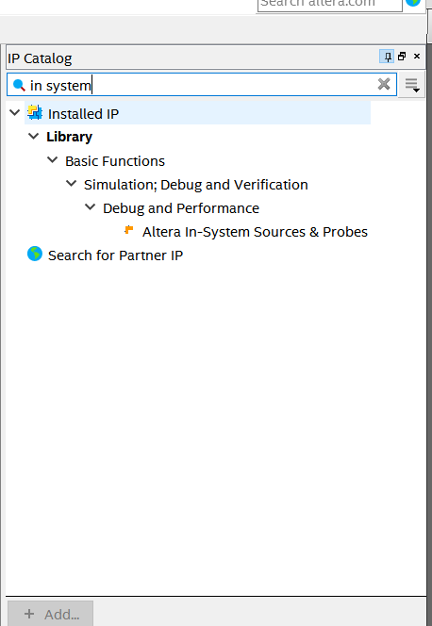
In-System Sources and Probes
ISSP allows an easy way to drive and sample signals in hardware and provides a dynamic debugging environment.
ISSP Editor consists of a probe function and interface to control the instances during run time.
It is operated over JTAG.
Each instance can drive and toggle values up to 512 signals.
Can create up to 128 instances of ISSP using IP Catalog
Notes:
Now, we move on to another debugging tool used for hardware debugging. In-System Sources and Probes (ISSP). Traditional debugging techniques often involve using an external pattern generator to exercise the logic and a logic analyzer to study the output waveforms during runtime. The In-System Sources and Probes Editor in the Quartus software extends the portfolio of verification tools, and allows you to easily control any internal signal and provides you with a completely dynamic debugging environment. The editor consists of a probe function and interface to control the instances running at the time. Also, each instance can drive and toggle up to 512 signals and upto 128 instances of ISSP can be created. ISSP can be found in the IP catalog of Quartus.

Slide 14
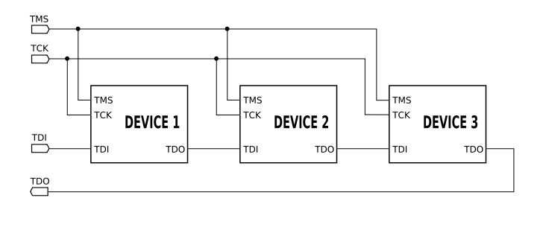
What is JTAG - Joint Test Action Group (IEEE 1149)
JTAG = JTAG is an industry standard for verifying designs and testing printed circuit boards after manufacture. JTAG implements standards for on-chip instrumentation in electronic design automation as a complementary tool to digital simulation.
FPGAs use this bus as one of the means to configure the device and interface with internal structures in the device
Standard 4 or 5 wire bus – used in many digital electronic devices for test and device specific configuration

Slide 15
USB Blaster Bridge Circuit
Development Kit with Integrated USB Blaster
Host PC
USB to JTAG Bridge
FPGA
FTDI
USB
JTAG
This device is commonly a small MAX series non-volatile device

Slide 16
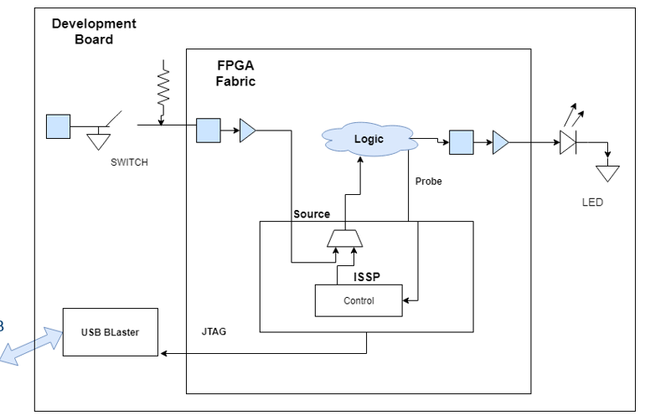
In-System Sources and Probes Block Diagram
Host PC
Host PC

Slide 17
Example Uses
Prototype a front panel with virtual buttons for a FPGA Design
Monitor results of changing design constants
Extensive TCL scripting support to create custom automated design control interfaces
Notes:
If we look into some example use cases of ISSP for debugging. We can use ISSP to prototype a front panel with virtual buttons for a FPGA design. We can use ISSP to monitor results of changing design constants as well as for extensive tcl scripting support to create custom automated design control interfaces. These are only a few examples where ISSP can be used.

Slide 18
SignalTap
Embedded Logic Analyzer

Slide 19
Why Signal Tap
+ Easily monitor signals – using simple to elaborate triggering schemes
+ No external equipment required
+ Don’t need to figure out stimulus since its based on actual hardware
Uses up lots of memory resources inside the chip
Can change timing of design
Requires recompile which takes time

Slide 20
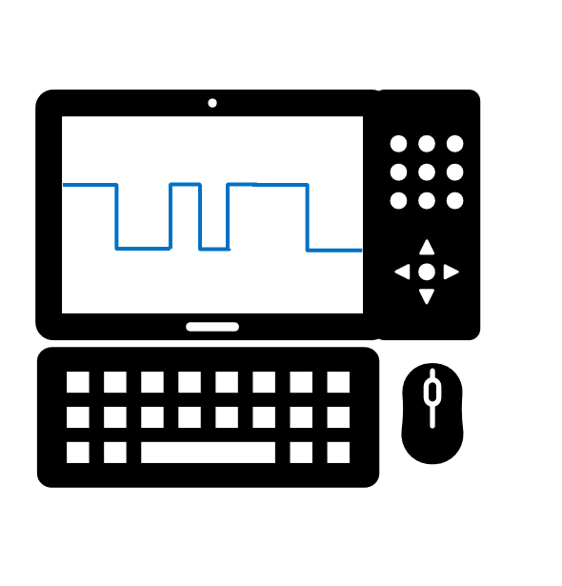
Debug of a Design with an External Logic Analyzer
Pros:
System-level debug
Can store large quantities of data
Flexible trigger condition
Cons
Signals must be physically accessible on the board by a probe
FPGA must have available I/O
If you need a new signal that isn’t accessible, you must make a new board
Probe equipment can potentially effect signal integrity
High quality probes prevents this, but tend to be expensive
Equipment expensive for hobbyist

Slide 21


Signal Tap Logic Analyzer
SignalTap is a logic analyzer made of available resources inside the FPGA
Uses available logic elements to implement the Logic Analyzer
Samples on-chip signals on the rising edge of a specified clock signal
View captured data through the standard JTAG connection typically used for programming the device
Notes:
Signal Tap Logic Analyzer is a logic analyzer made of available resources inside the FPGA
It uses available logic elements to implement the Logic Analyzer. It samples on-chip signals on the rising edge of a specified clock signal and views captured data through the standard JTAG connection typically used for programming the device.

Slide 22
Debug of a Design with Signal Tap
Pros:
Tap signals buried deep in the design
No unassigned I/Os or routing needed
Comes free with all versions of Quartus, no external test equipment required
Tap new signals with the same board by reconfiguring, recompiling, and reprogramming (no re-spin!)
Cons
Requires additional device resources (memory and logic elements) – doesn’t change base function, but changes timing
Must have an active JTAG connection
Notes:
The reason why debugging with signal tap is helpful is because it taps into signals buried deep into the design. Also, you do not need to route or unasssign I/Os. It is freee with all versions of Quartus and to tap new signals on the same board, you just have to recompile the design – no respin needed. But, there are a few cons to signal tap as well. You can only perform functional debug, any timing delays inherent in the design will not appear in the sampled data as data is only sampled at rising edge of clock. Another drawback is that you need additional device resources because signal tap uses those resources to function. Also, you need a JTAG connection for your debugging. But, all-in-all signal tap is a very useful tool for debugging.

Slide 23
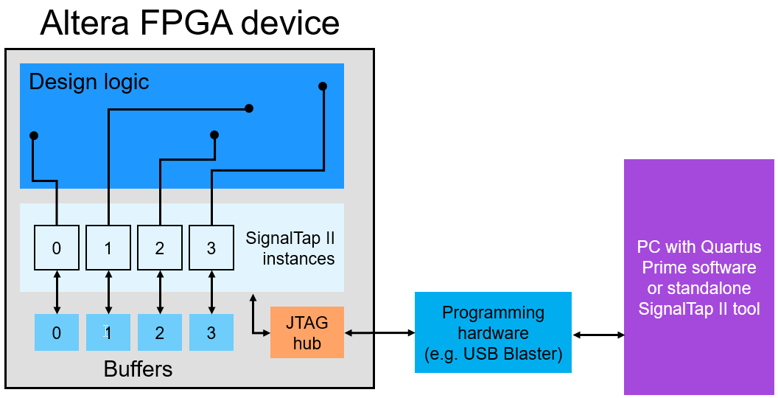
What is Signal Tap ?
Notes:
The logic Analyzer is created in the logic device using unused logic elements and memory blocks. To illustrate how it is implemented, here is an FPGA device programmed with a design. Multiple instances of the signal tap are added to the design each with its own buffer for storing captured data. Each instance is configured to tap desired signal nodes for monitoring or to define trigger conditions. JTAG is used to program the device and for controlling operations for signal tap instances after device programming.

Slide 24
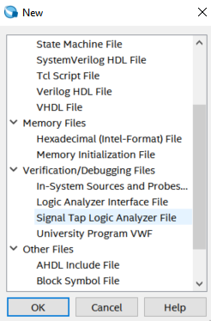
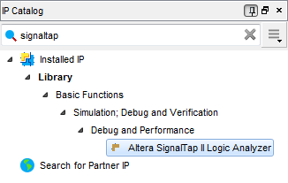
Create a Signal Tap instance in two ways
Use Signal Tap file (.stp) (recommended)
Creates a file (.stp) separate from design files
Convenient features and GUI
2. Use IP Catalog and IP Parameter Editor
Manually instantiate altera_signaltap_ii_logic_analyzer IP core directly into HDL code or Qsys (Platform Designer)
Ties the ELA to the signals directly in RTL
Notes:
Now that we understand how signal tap logic analyzer works. We now look at how to instantiate the signal tap analyzer. There are two ways to do the same. First is to create a signal tap file using a new file option. It is the easiest way to use signal tap. Second is to create an HDL code source file using the IP Catalog and IP Parameter editor. The IP core is called Altera SignalTap II logic Analyzer. This allows you to adjust all the basic parameters needed to create a single signal tap instance. The ELA implement in this manner can be controlled from command line or by creating a related signal tap file. This training focuses on signal tap usage by creating a .stp file as it is the easiest way to use signal tap.

Slide 25
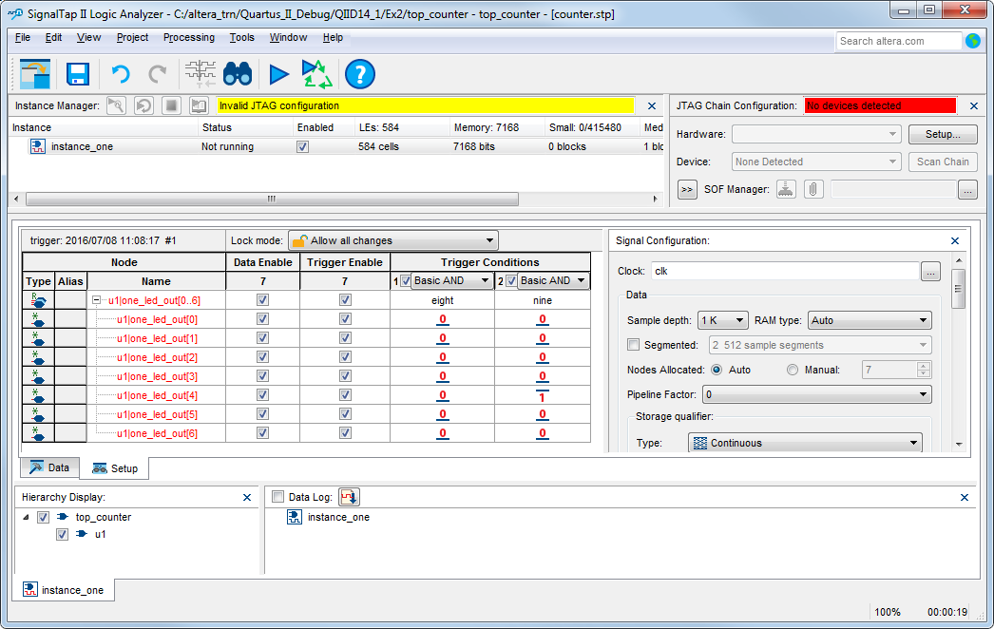
Signal Tap Logic Analyzer Window
Instance Manager
Identifies which instance is being edited in the GUI
Enable/Disable instances quickly
Gives status and resource utilization (LEs and memory)
Notes:
The main signal tap window has various panes for different functions. Each pane has different settings and configuration options. Instance manager includes number of controls to work with individual or multiple instances. The highlighted instance is the active instance and all the changes only affect the current instances. To create new instances right click the instance and click on create instance. You can rename instance by right click the instance. For each instance the instance manager displays the current status of the instance as well as estimate of the resource used by the instance. Once, the signal tap starts running the status of the instance will change.

Slide 26
Signal Tap Logic Analyzer Window
JTAG Chain Configuration
Built in “Programmer”
Scans the JTAG chain and identifies available devices
Notes:
JTAG Chain configuration is a built in programmer present in the signal tap editor window for programming the file onto the board. It scans the JTAG chain and identifies the available devices and finds the device for programming.

Slide 27
Signal Tap Logic Analyzer Window
Nodes List
Use the Node Finder to add signals to be tapped
Automatically groups busses together and create custom groups
Notes:
The nodes list on the setup tab is used to select signals from design for monitoring or triggering as well as constructing trigger conditions. Custom groups can be created to group similar signals.

Slide 28
Signal Tap Logic Analyzer Window
Trigger Conditions and Qualifiers
Data Enable: Saves signal data (disable to save memory)
Trigger Enable: Signal is part of the trigger condition (disable to save LEs)
Notes:
To

Slide 29
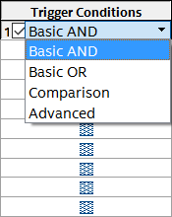
Signal Tap Logic Analyzer Window
Trigger Conditions
Add up to 10 trigger conditions
Choose how every node is compared
Notes:
Once nodes are added to the node list, there are many options for trigger conditions. For basic trigger conditions, you can choose from Basic AND, Basic OR, Comparison or Advanced. For example, Basic AND will just boolean and all the specified trigger conditions.

Slide 30
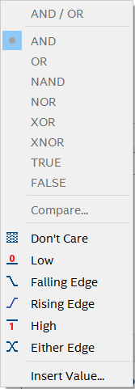
Signal Tap Logic Analyzer Window
Trigger Conditions
Add up to 10 trigger conditions
Choose how every node is compared
Choose what action triggers a specific node
Notes:
To set a trigger condition for each node. There are various levels it can be set at, like don’t care, low, falling edge, 1 0 etc.

Slide 31
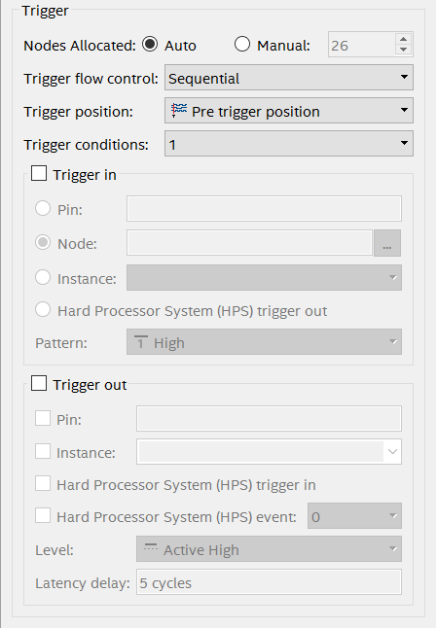
Signal Tap Logic Analyzer Window
Signal Configuration
Advanced trigger control
Select the number of trigger conditions
Trigger In/Out options
Notes:
Signal Tap also offers advanced trigger conditions and its control. In the signal configuration tab, you can choose the number of trigger conditions, trigger in/out options and trigger position.

Slide 32
Signal Tap Logic Analyzer Window
Data/Setup Window
Setup allows configuration of nodes and trigger conditions (for making edits)
Data shows the acquired signal information (for viewing results)
Notes:
Once, the analysis is run you can use the setup window to view the configuration of nodes and trigger conditions. The data tab shows the acquired signal information.

Slide 33
Lab Exercise 2: In-SYSTEM SOURCES AND PROBES Lab Exercise 3: SIGNAL TAP

